Slide 1

Combating Crypto-Jacking By Analysing Application Behaviour Through Machine Learning
Group Members:
Muhammad Affan Khan(19P-0045)
Rana Rehan Qaisar (19P-0077)
Muhammad Istafa Malik (19P-0033)
Project Supervisor:
Dr. Muhammad Amin

Slide 2

Introduction
The practice of "crypto jacking" entails taking control of a computer to mine crypto currencies against the user's wishes, through websites, or when the user is unaware.
Host based crypto jacking
Browser-based crypto jacking

Slide 3
Problem Statement
“Attackers are continually changing their malware & strategies to avoid detection,current methods employ outdated data. In order to prevent crypto jacking, a novel and strong strategy utilising machine learning techniques is needed.”

Slide 4
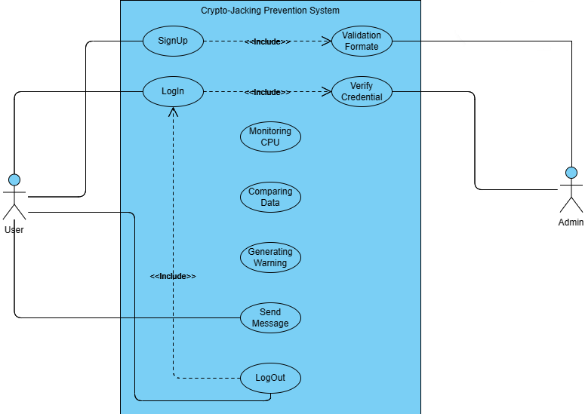
Use Case Diagram
Figur: 1 User Interaction with application

Slide 5
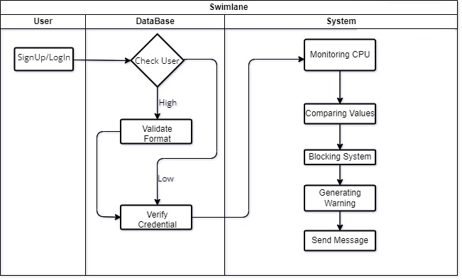
Swim lane Diagram
Figur: 2 Sequence of activities in the system

Slide 6
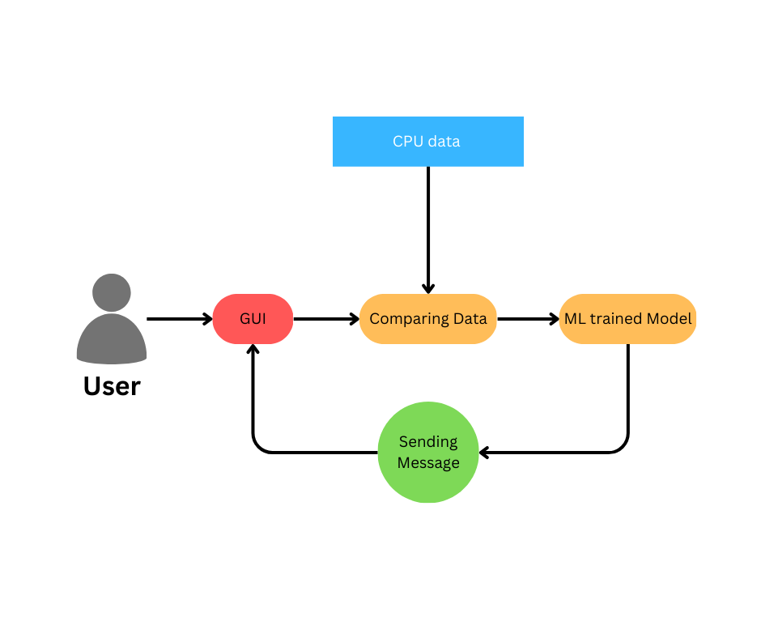
Proposed System
Figure:3 General Diagram of Application

Slide 7
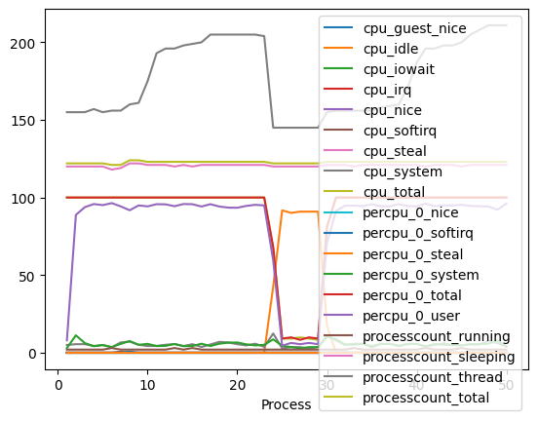
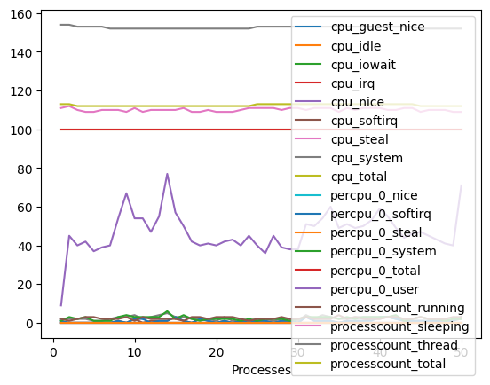
Data Set review
The data set we chose was about the behavior when an app was installed onto the system and as a result, at the back end, crypto jacking was done. The two data sets compare the performance measure of the system before the app was installed and after the app was installed.
Benign Graph
Malicious Graph

Slide 8
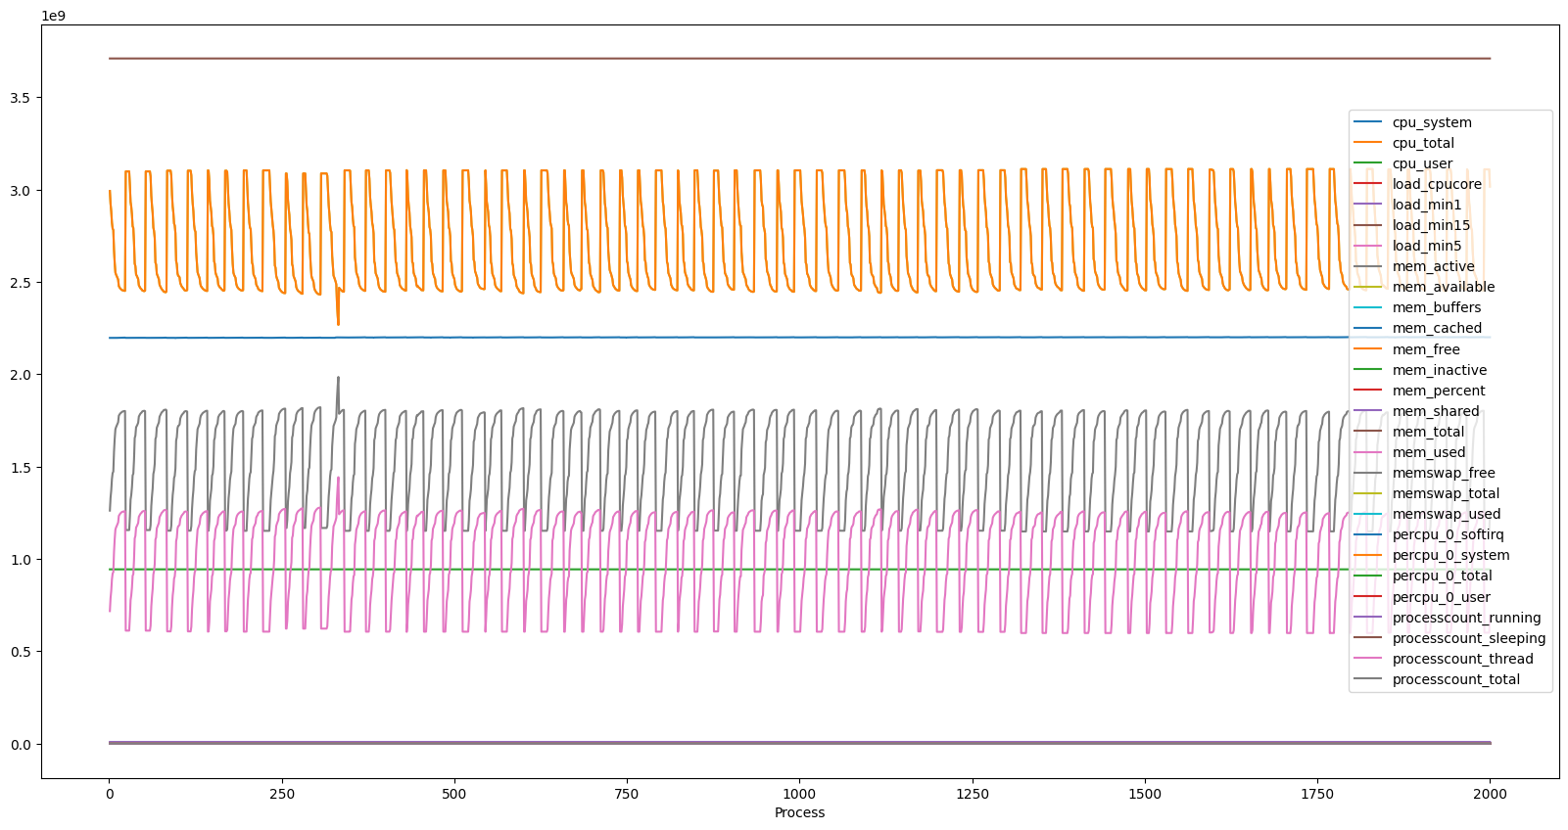
After Pre-processing
Benign Graph

Slide 9
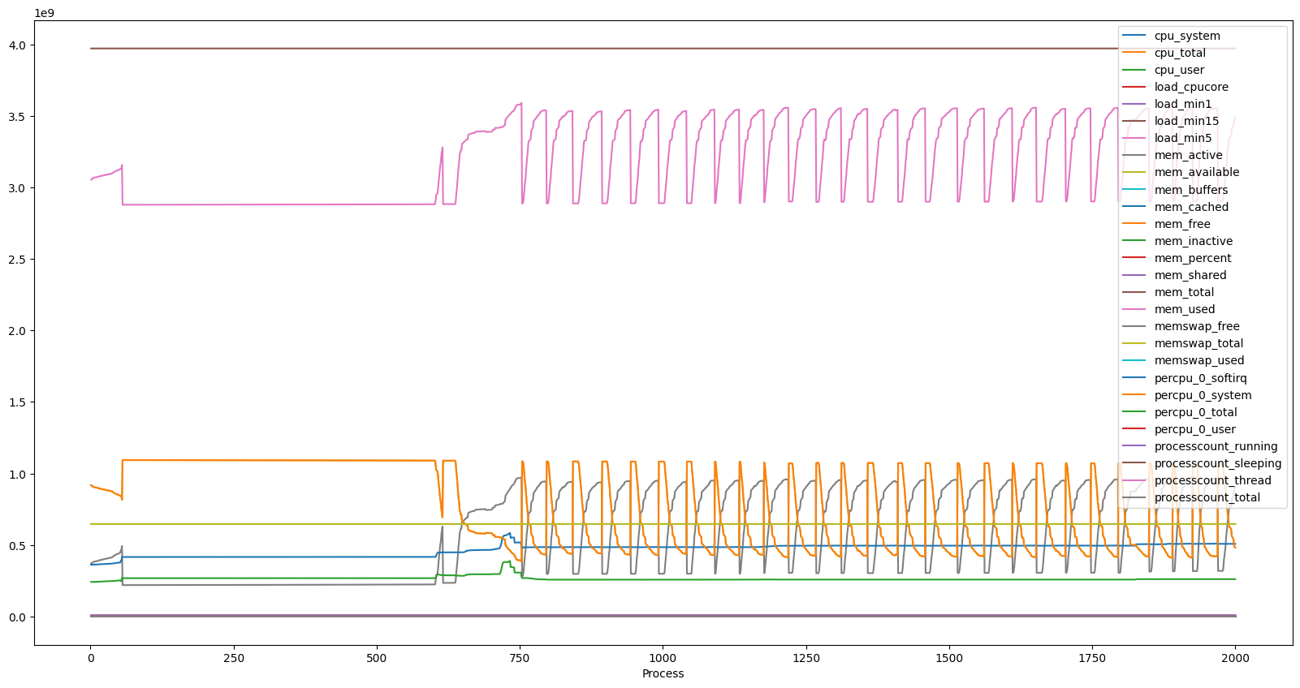
After Pre-processing
Malicious Graph

Slide 10
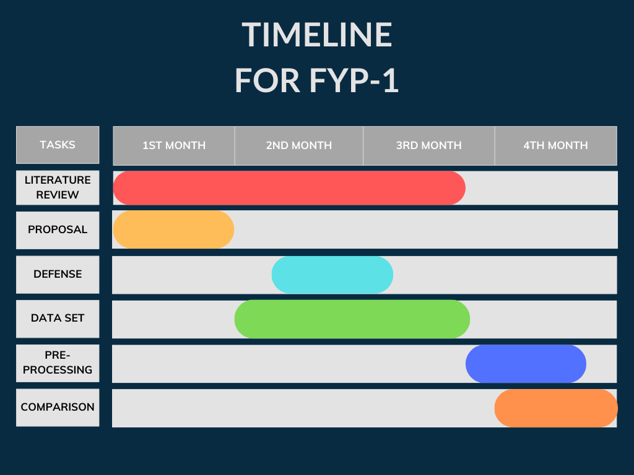

Slide 11
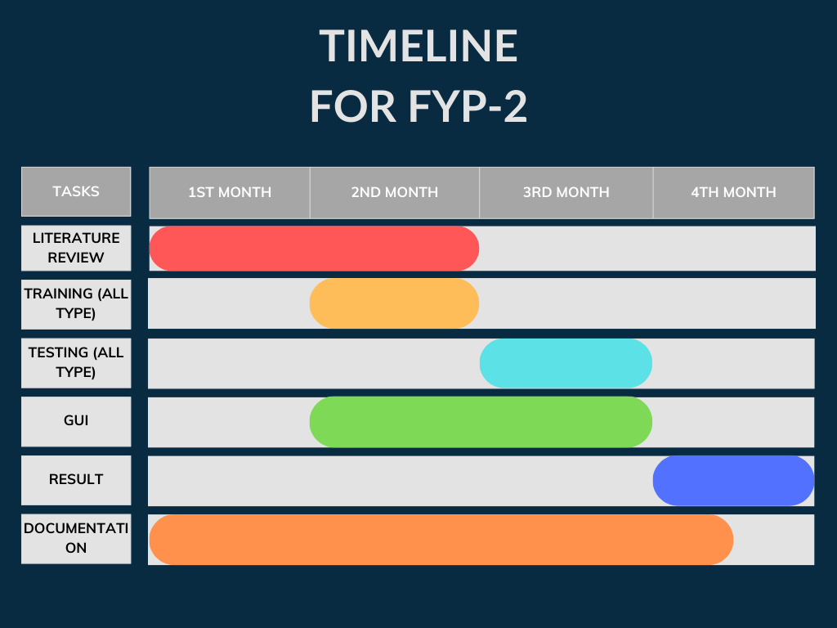

Slide 12
Team Work
Literature Review (Affan,Rehan,Istafa)
Presentations(Rehan,Istafa)
Report(Affan)
Pre-Processing(Rehan,Istafa)
Diagrams(Affan,Rehan)
Comparing Data Set(Affan,Istafa)

Slide 13
References
[1]Moreno-Sancho, Alejandro A., et al. "A data infrastructure for heterogeneous telemetry adaptation. Application to Netflow-based cryptojacking detection." 2023 26th Conference on Innovation in Clouds, Internet and Networks and Workshops (ICIN). IEEE,2023.
[2]Darabian, Hamid, et al. "Detecting crypto mining malware: a deep learning approach for static and dynamic analysis." Journal of Grid Computing 18 (2020): 293-303.
[3]Xu, Guangquan, et al. "Delay-CJ: A novel crypto jacking covert attack method based on delayed strategy and its detection." Digital Communications and Networks (2022).
[4]Vanlioglu, Said, et al. "The dangerous combo: Fileless malware and cryptojacking." SoutheastCon 2022 (2022): 125-132.
[5]Naseem, Faraz Naseem, et al. "MINOS: A Lightweight Real-Time Cryptojacking Detection System." NDSS. 2021.
[6] Khan Abbasi, Muhammad Haris, et al. "A Real-Time Hybrid Approach to Combat In-Browser Crypto Jacking Malware." Applied Sciences 13.4 (2023): 2039.
[7] Data Set: Cryptojacking Attack Timeseries Dataset | Kaggle

